Slide 1


Sales Insights - Data Analysis Project using Tableau
By – Vladyslav Nyzhnyk
github.com/VladyslavNyzhnyk/
in/vladyslav-nyzhnyk-41ab12297/

Slide 2
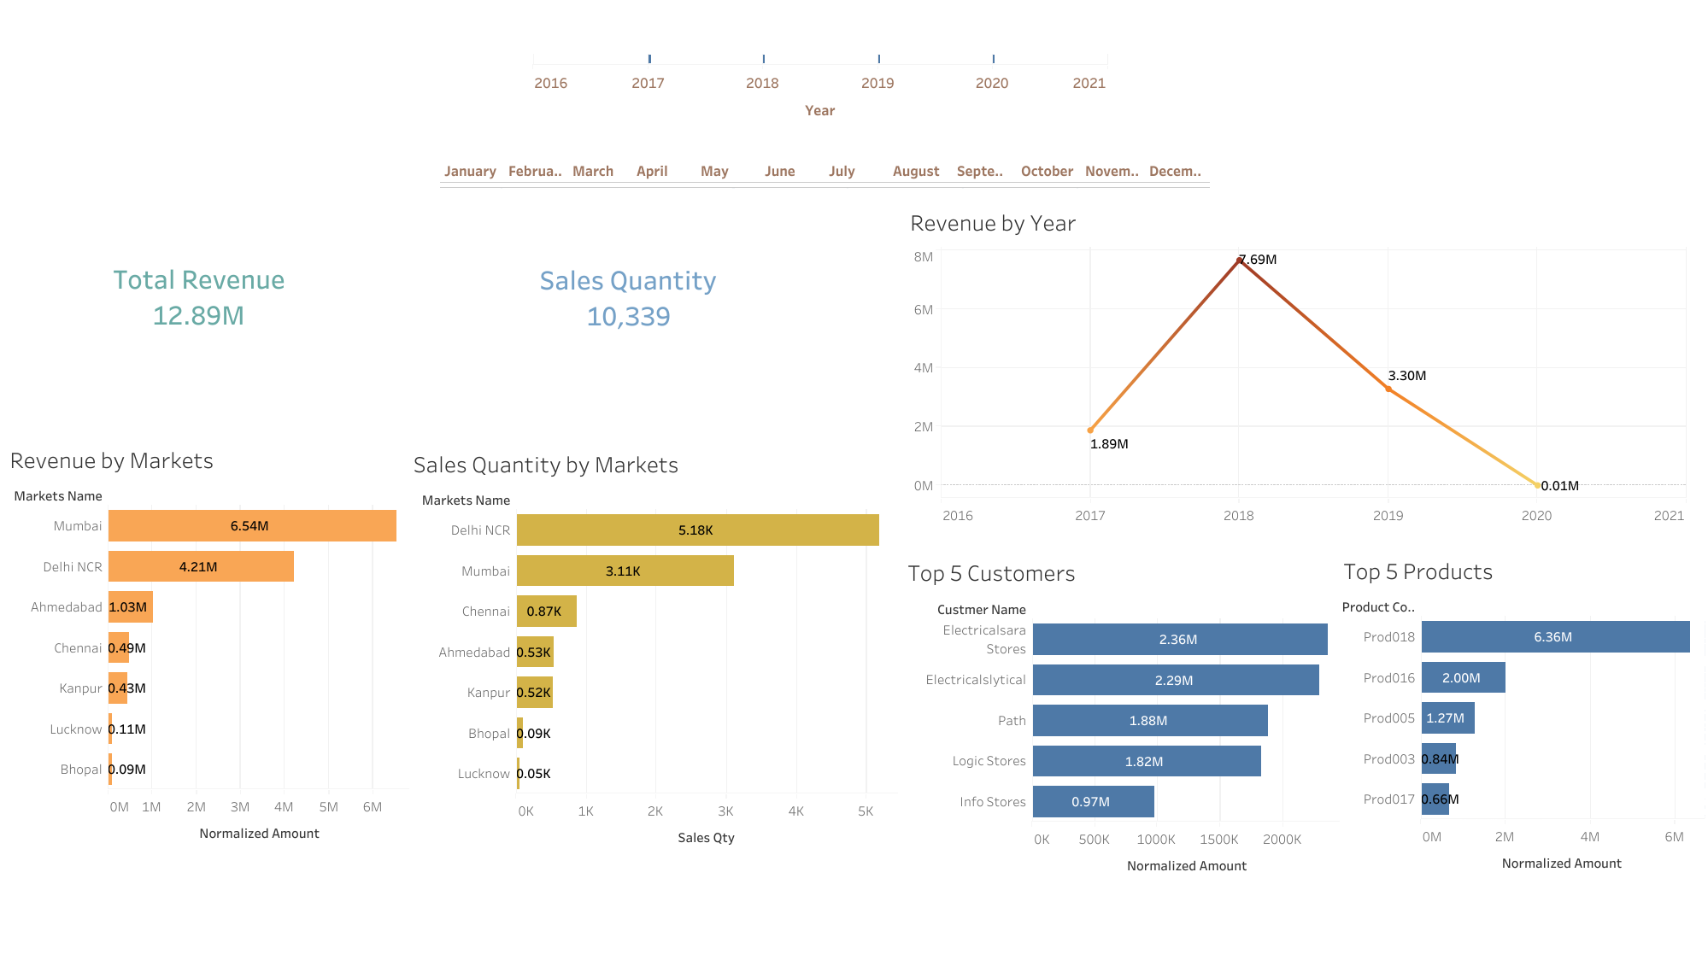

Slide 3
